Slide 1
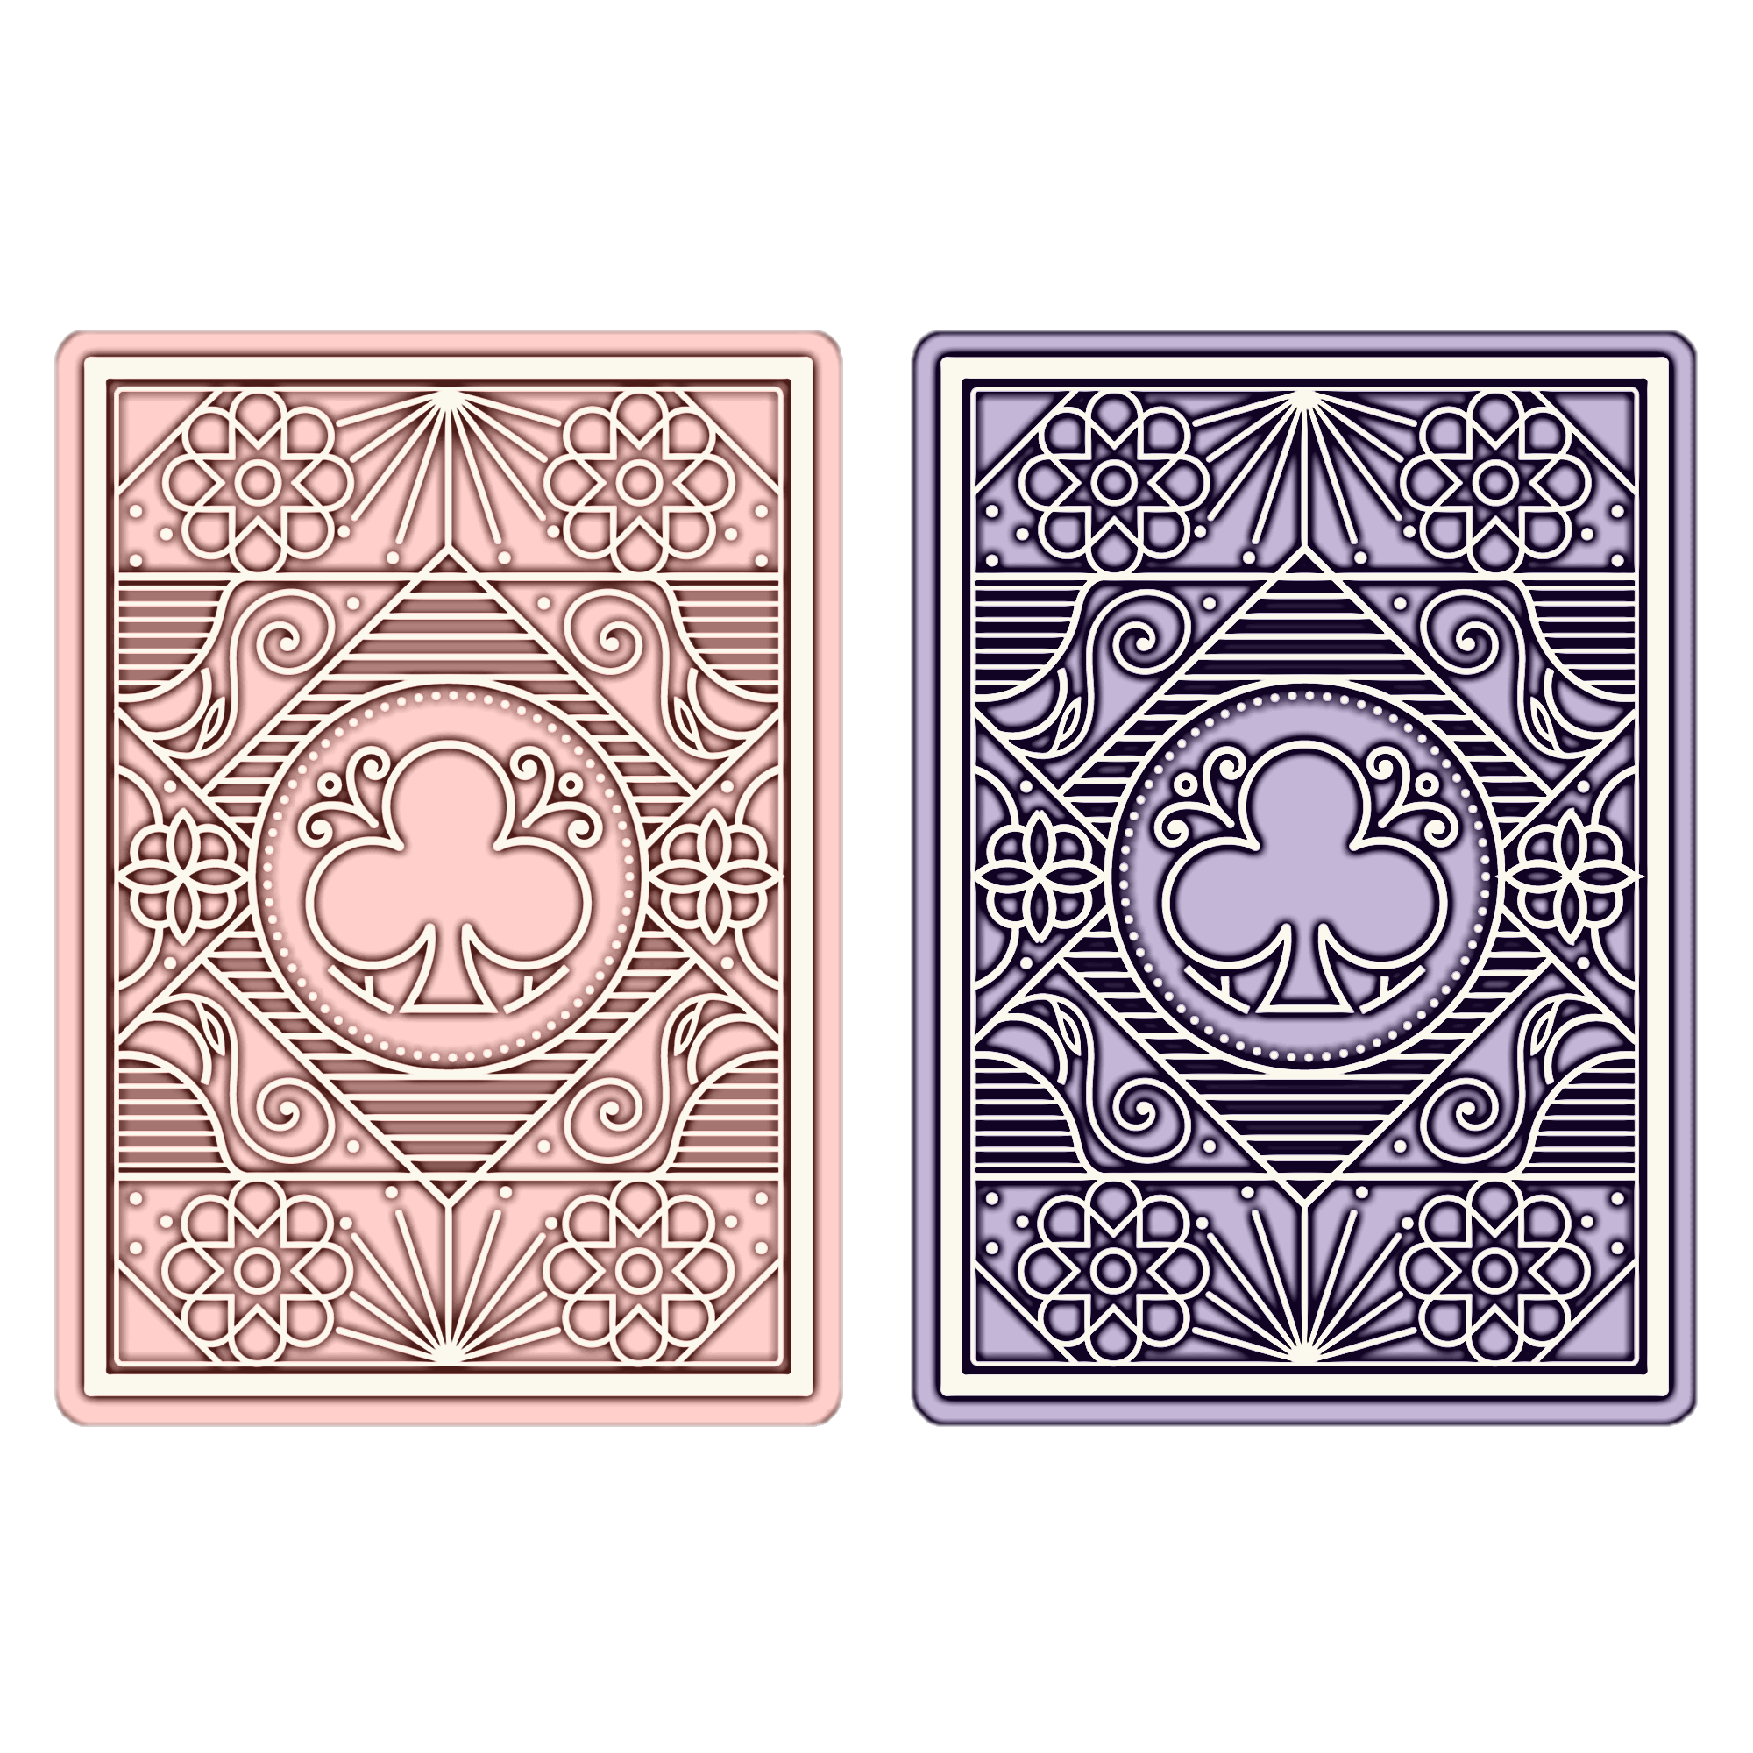
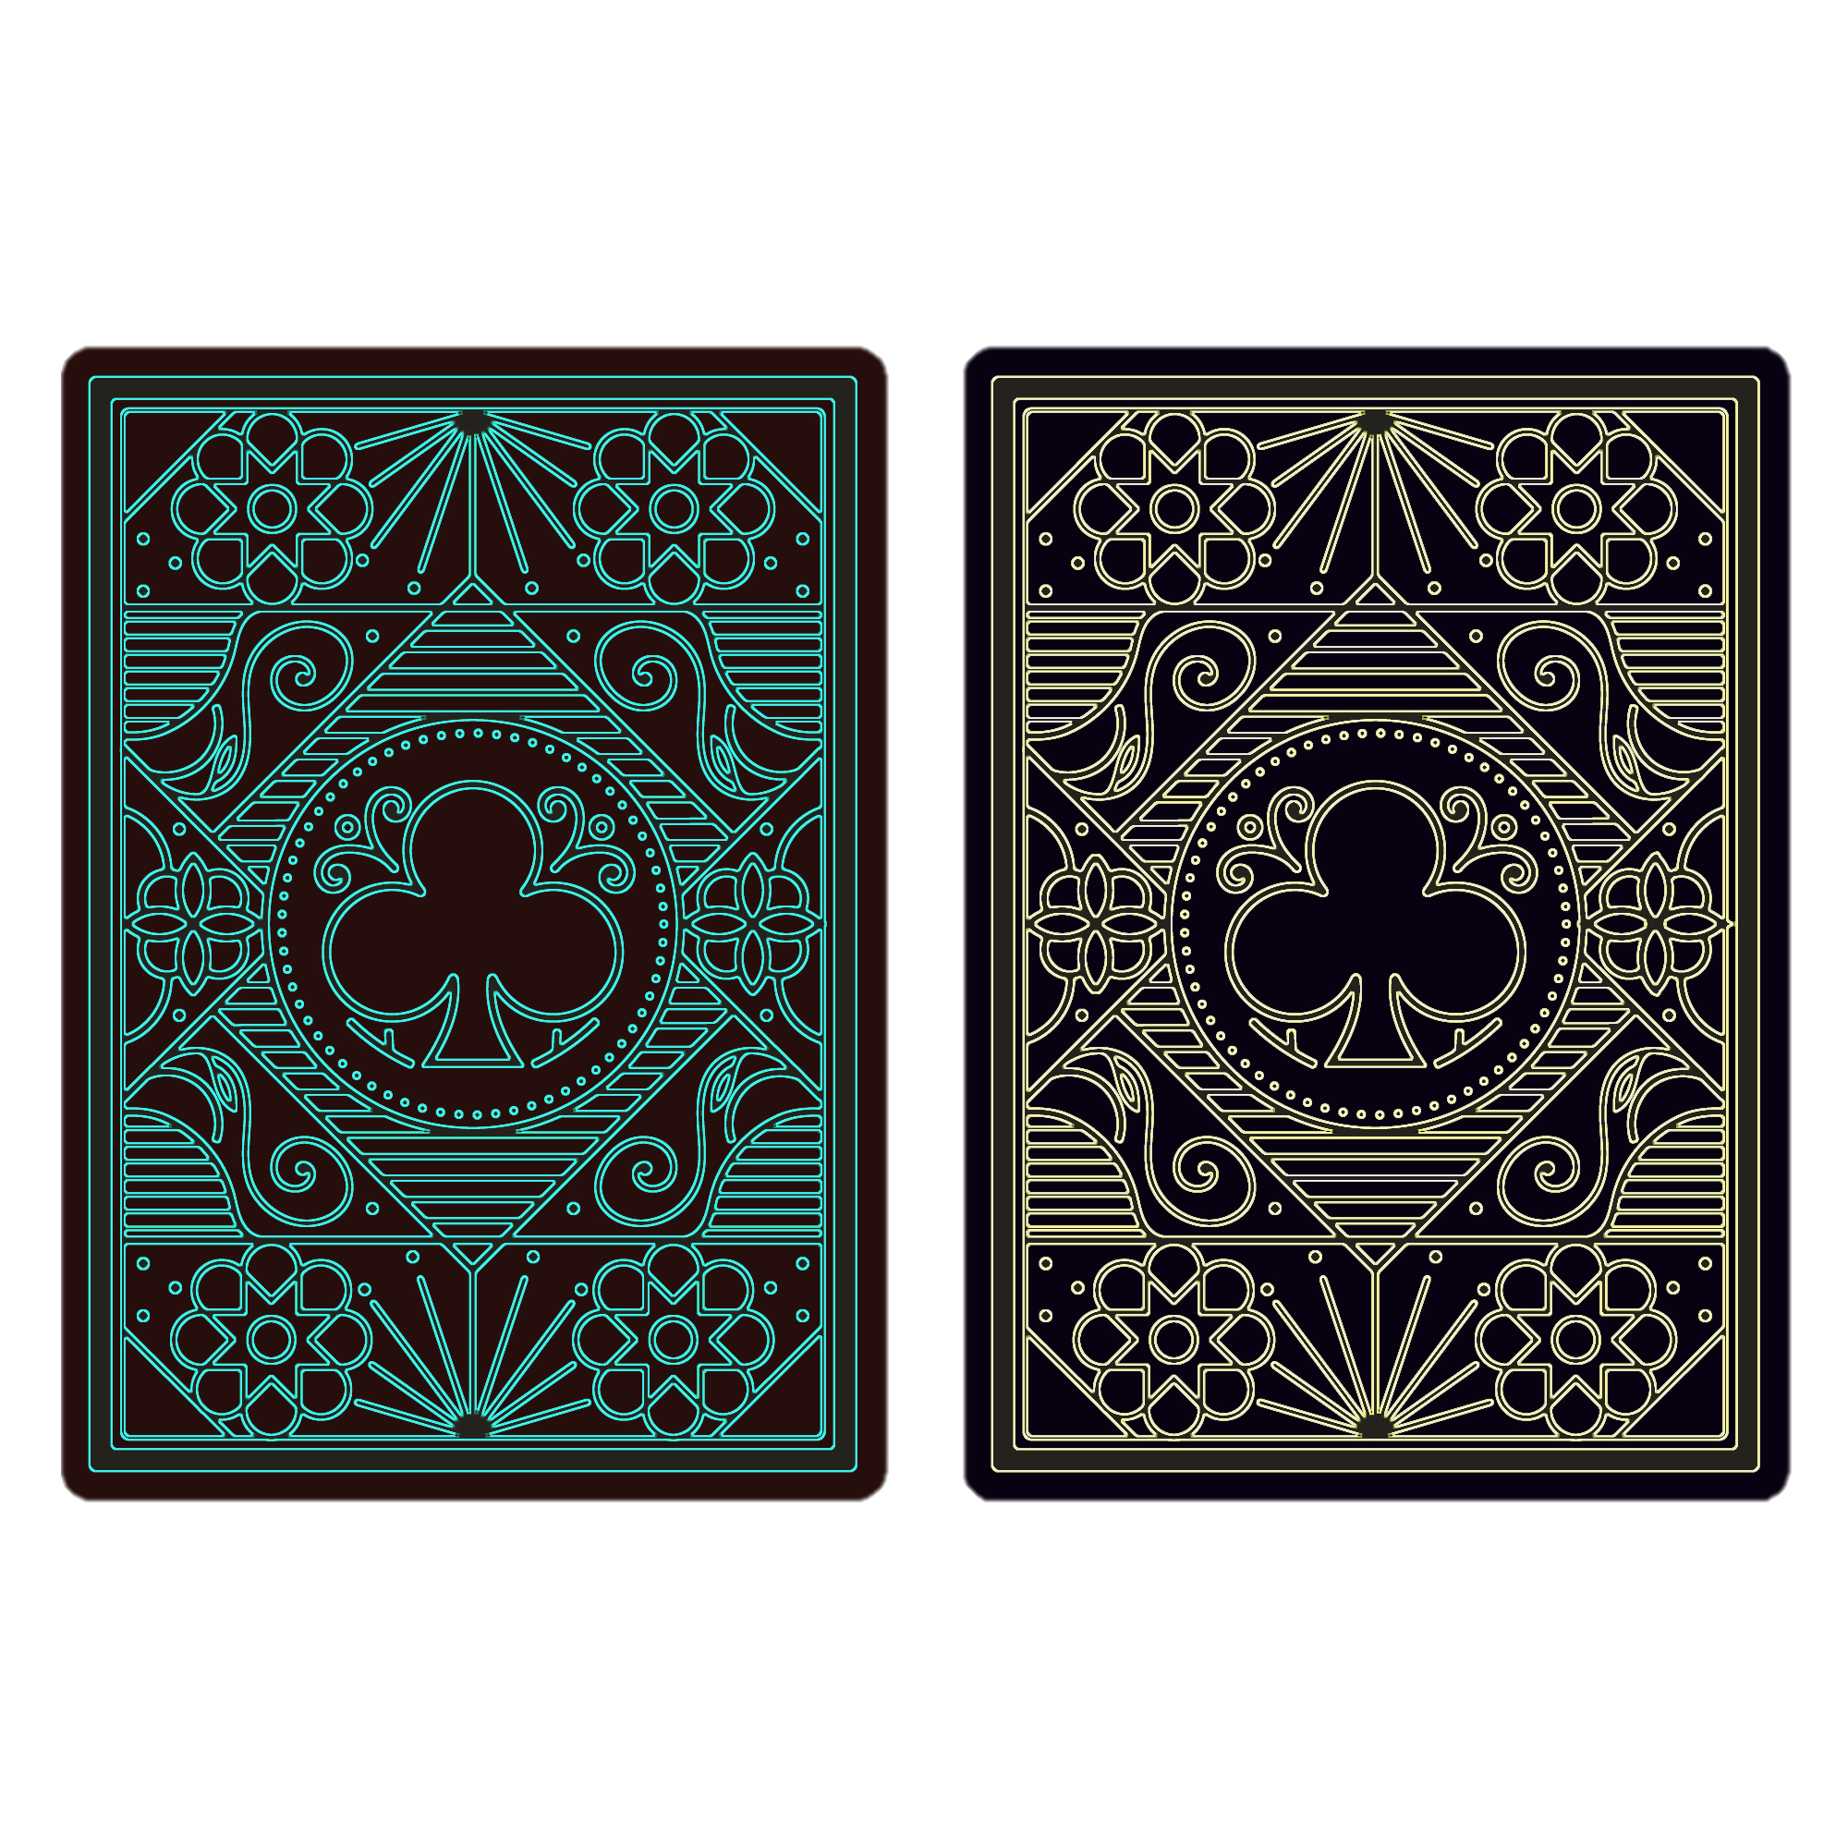

Slide 2
You won £1000!
You won £50!
You won £1000!
You won £50!
You won £1000!
Sorry, there’s a penalty of £250
You won £50!
Sorry, the penalty is a forfeit of your winning
You won £1000!
Sorry, there’s a penalty of £250
You won £50!
Sorry, the penalty is a forfeit of your winning

Slide 3
You won £1000!
Sorry, there’s a penalty of £250

